Slide 1
Under the Sun Drink Mixer
Group 4
Laura Cano
Moises Dominguez
Michael Tyrlik
Stephen Zimmerman
Notes:
October 27, 2005
*

Slide 2

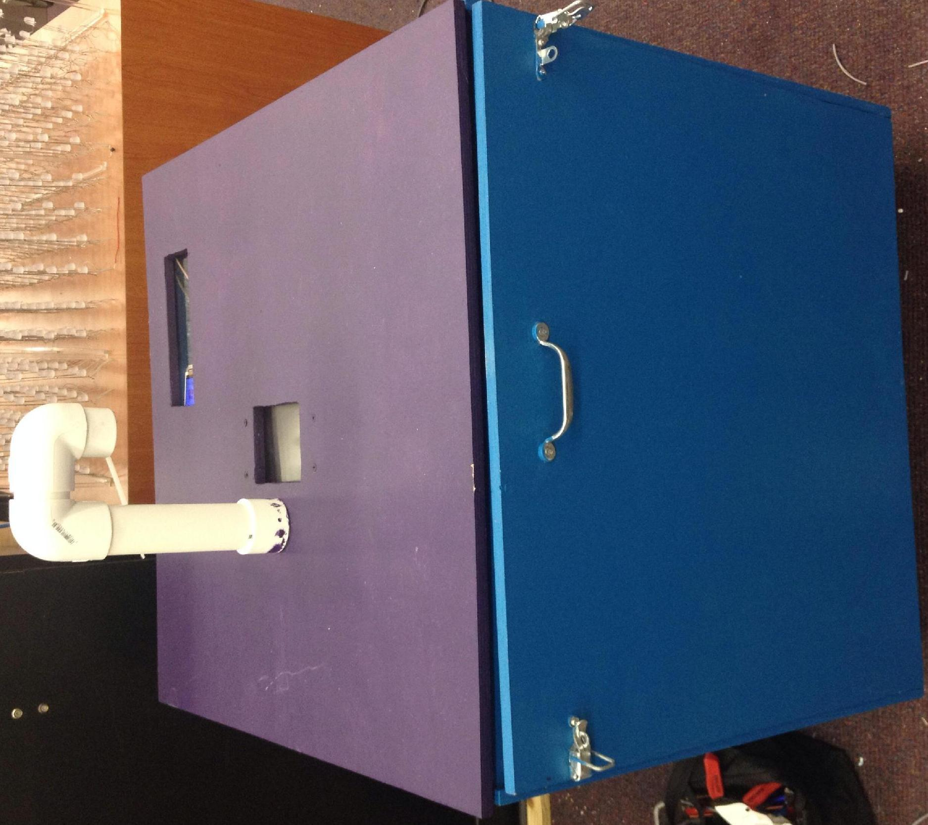
What is it?
Drink Mixer
Solar Powered
Automated
User Friendly
Portable

Slide 3
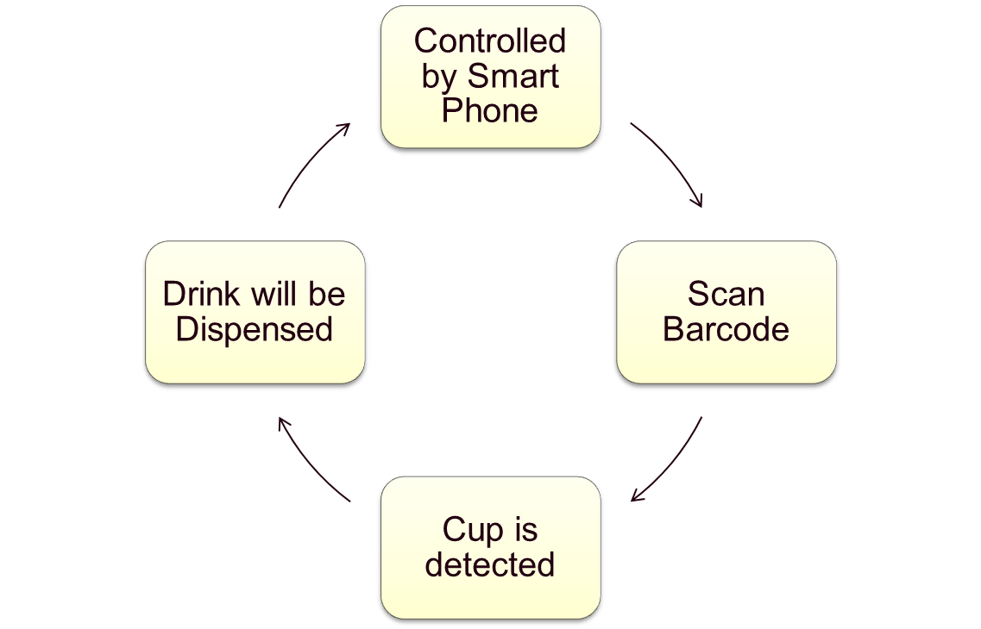
How Does It Work?

Slide 4
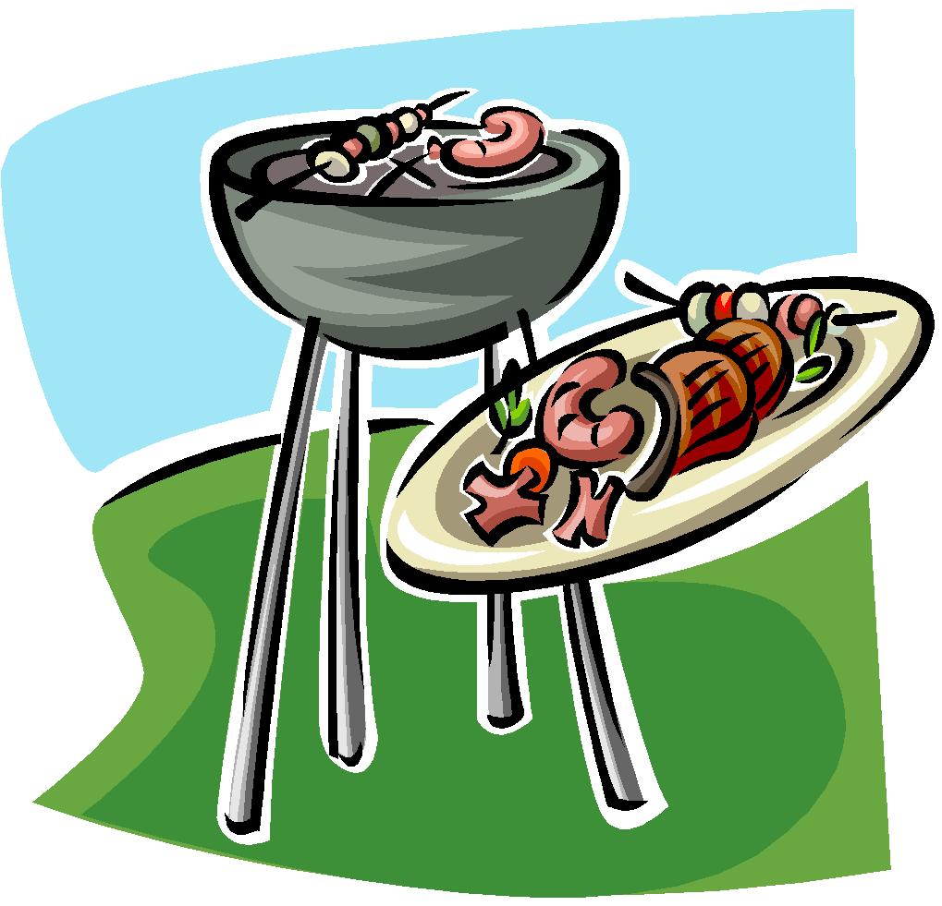
Applications
Ideal for BBQs and tailgates
Avoid long queues to serve a drink, it’s controlled by your phone
Increases social interaction by reducing time spent at serving drinks

Slide 5

Goals & Objectives
Facilitate mixing of drinks
Make a portable design for easy transportation
Controlled by smartphone with a user friendly interface with a library of predetermined drinks to choose from.

Slide 6
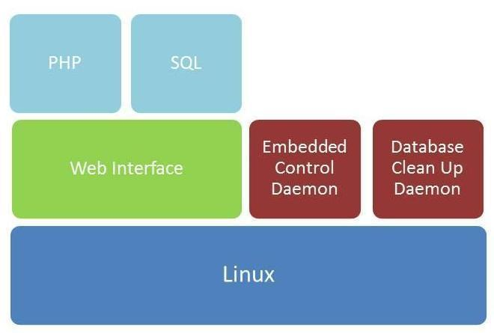
Software Architecture

Slide 7
Client Sofware
iPhone
Web Service
SQL
Dispensing Coordinator
CB Software
BeagleBone
Control Board

Slide 8

Client App
iPhone only
Four primary functions
  Browse menu
  Order
  Pickup
  Maintenance

Slide 9
Browse the Menu
Users are presented with a menu of predetermined drinks.
Predetermined drinks show the ingredients used to create the drink
Ordering is an asynchronous process, allowing user to browse through other areas when order is taking place

Slide 10
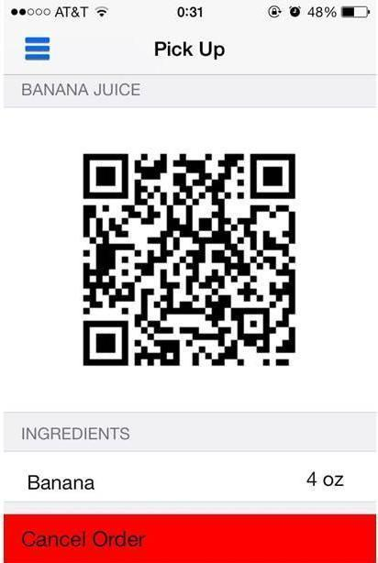
Pickup Drinks
Reservation only valid for 10 minutes
Barcode will be presented and manually dismissed

Slide 11
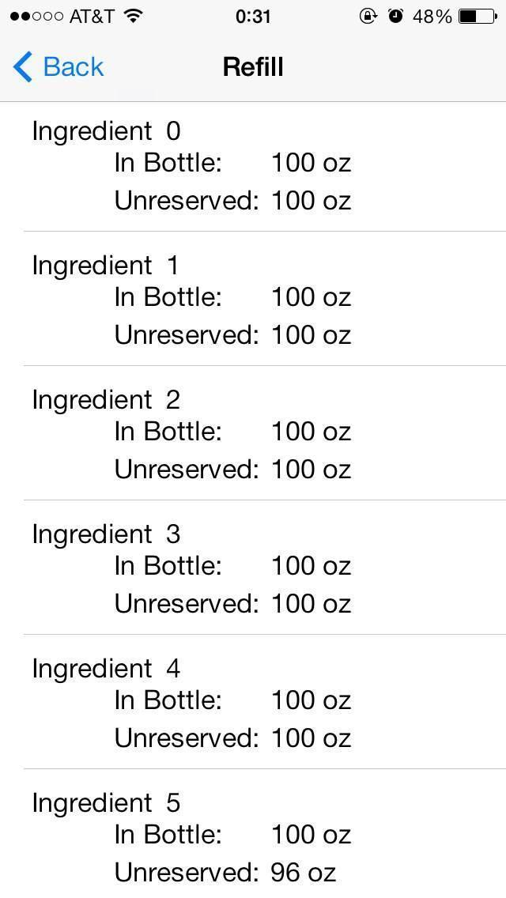
Maintenance
iOS application can query the database to determine amount of unreserved ingredients
Ability to update the fill level of the ingredient canisters directly from the iOS application.

Slide 12
LAMP
Linux
Apache (open source web server)
MySQL (Database Management System)
PHP (Web page communication)

Slide 13
Web Service
iPhone
Web Service
SQL
Dispensing Coordinator
CB Software
BeagleBone
Control Board

Slide 14
Web Service
Coded using PHP
Send data using POST requests
Data returned using JSON
Allows us to:
  Order Drinks
  Check Drink Status
  Cancel Drink
  Check Canisters
  Refill Canisters

Slide 15
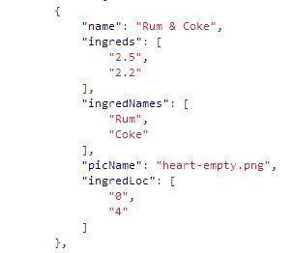
Menu
Stored on Server
Encoded in JSON

Slide 16
Database
iPhone
Web Service
SQL
Dispensing Coordinator
CB Software
BeagleBone
Control Board

Slide 17
Database
Will store ordered drinks and ingredient levels
When the user chooses their drink and places their order, the database will be updated with that drink order with its associated ingredients and a drink ID associated to the barcode

Slide 18
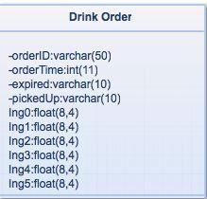
Database Schema

Slide 19
Ingredient Levels
When an order is placed, the drink ingredients associated will be reserved
The Ingredient Levels table will be updated based on the ingredients reserved

Slide 20
Database Cleanup Daemon
A Daemon will be implemented to prevent users from ordering drinks and not picking up those drinks
Enforces expiration timers
Reallocates expired drinks ingredients
Deletes barcodes

Slide 21
Control Board Software
iPhone
Web Service
SQL
Dispensing Coordinator
CB Software
BeagleBone
Control Board

Slide 22
Dispensing Coordinator
Waits for barcodes to be scanned
Verifies barcode is valid
Sends dispense commands to Control Board
Updates the database when successfully dispensed

Slide 23
Control Board Software
iPhone
Web Service
SQL
Dispensing Coordinator
CB Software
BeagleBone
Control Board

Slide 24
Control Board Software
In charge of opening solenoids and verifying cup is present
Controls LCD Display
The Control Board will receive instructions serially via UART
Communicates with the Dispensing Coordinator on the BeagleBone for instructions

Slide 25
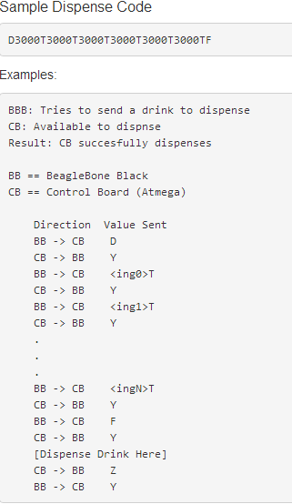
Control Board Software Example
Command | Meaning
T | End Line
Y | Yes
N | No
D | Dispense
F | Finished
Z | Finished dispensing the current drink

Slide 26
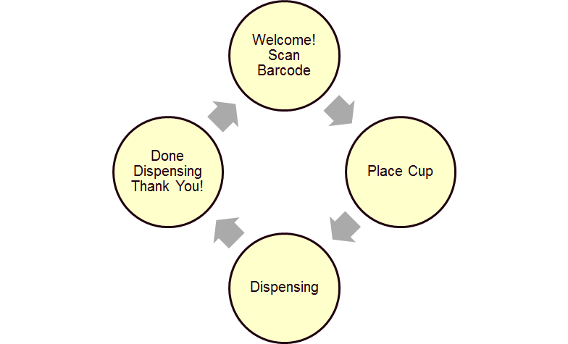
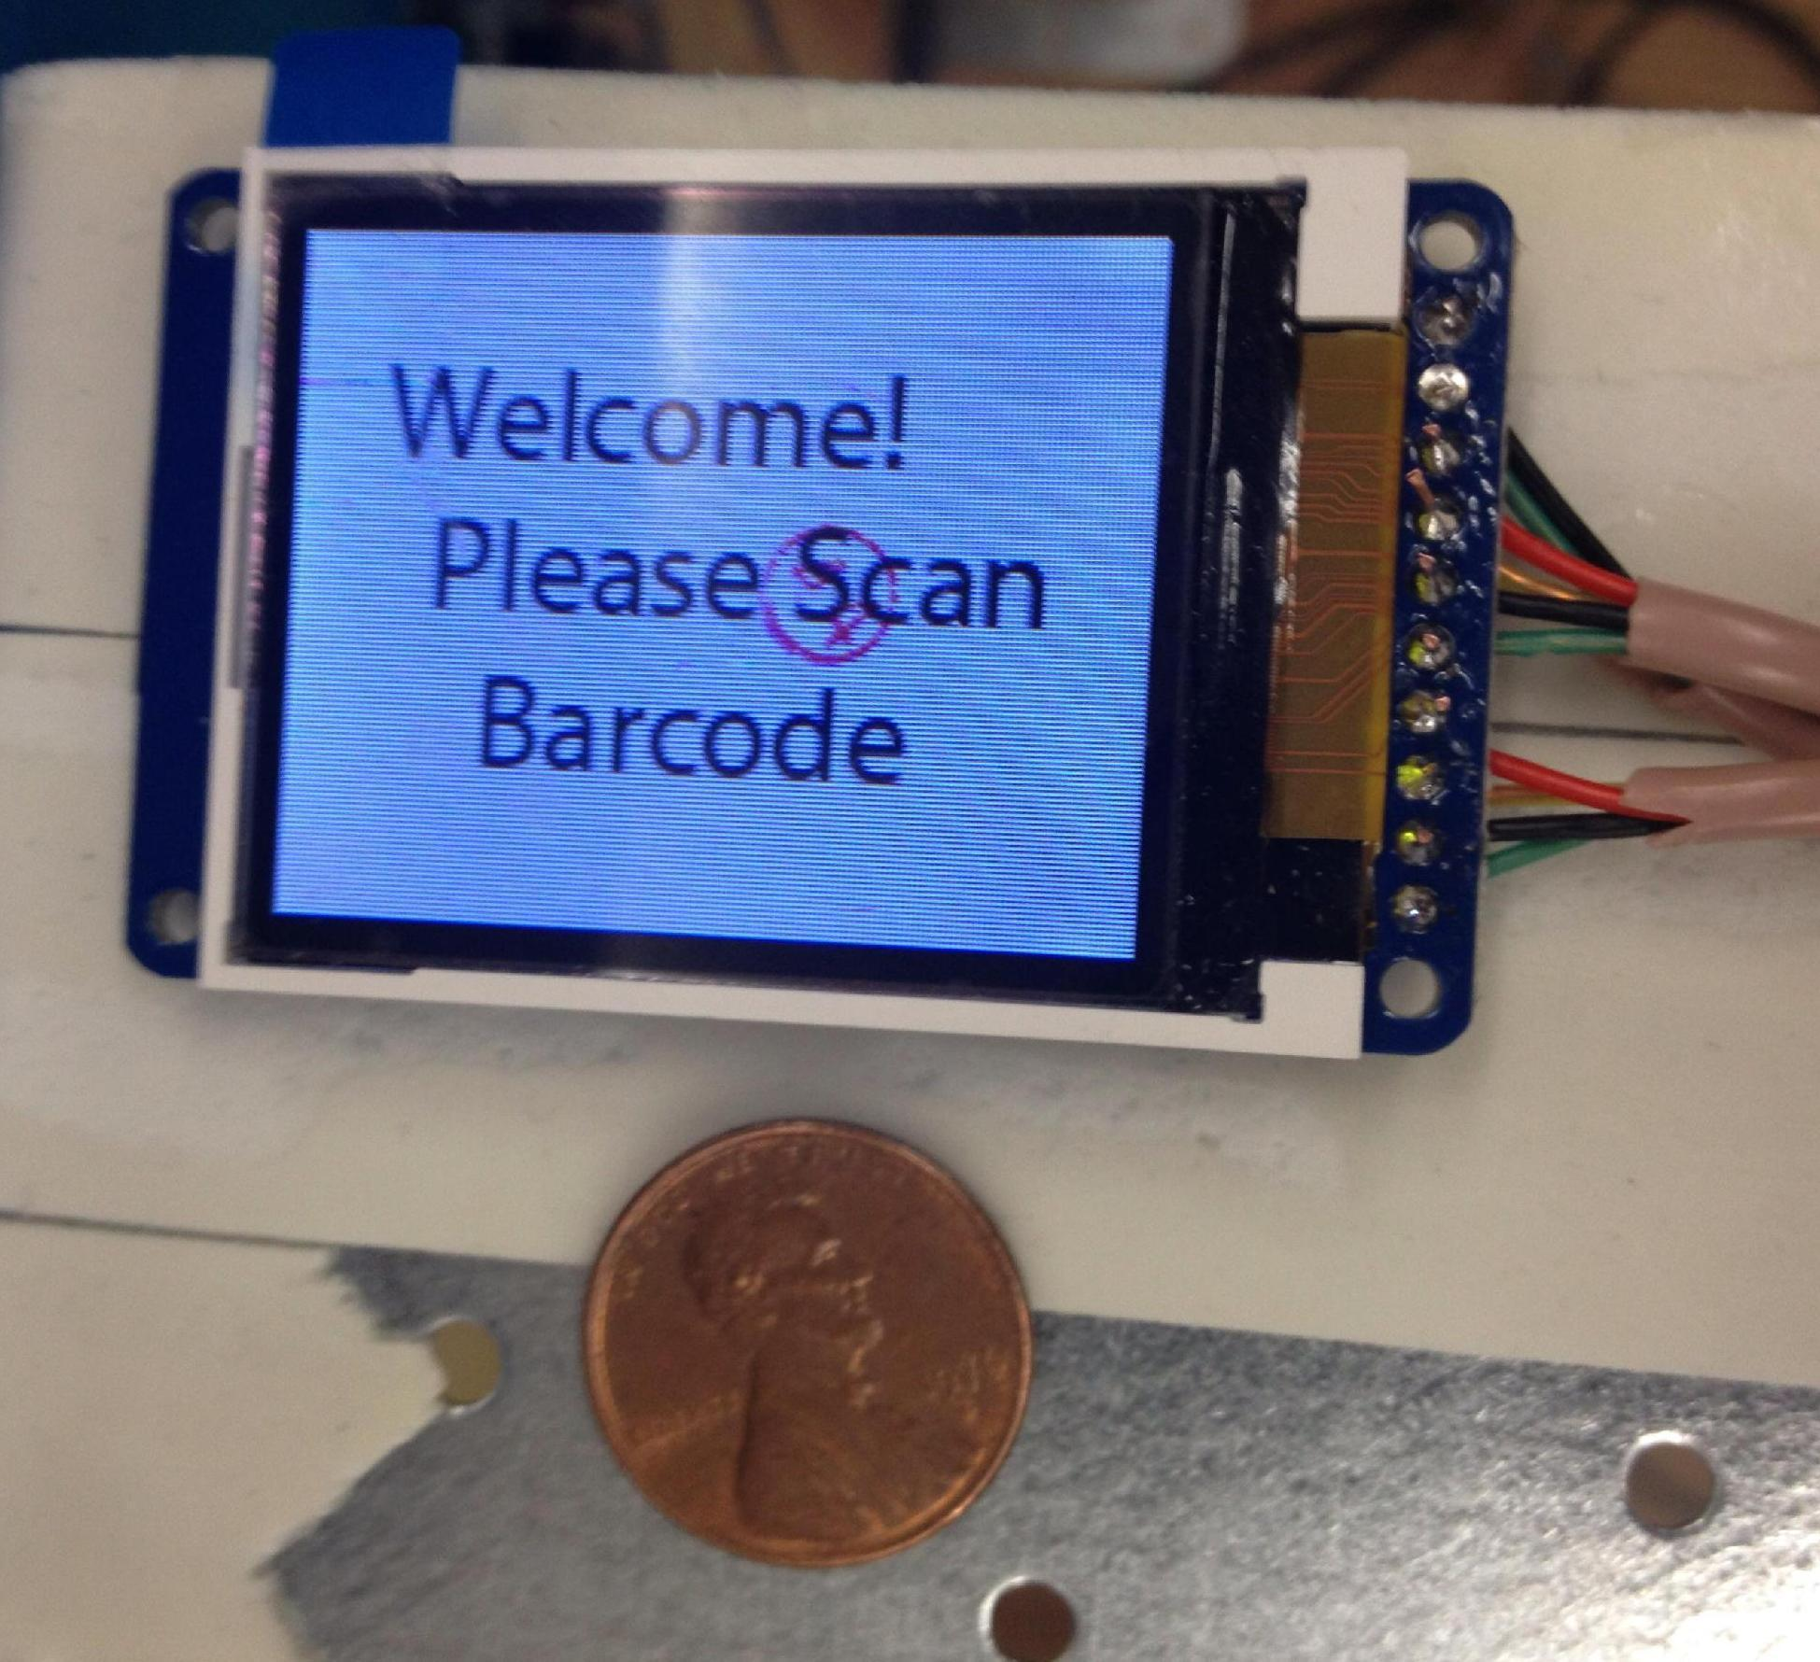
Model Design – LCD Screen

Slide 27
Hardware Overview
iPhone
Web Service
SQL
Dispensing Coordinator
CB Software
BeagleBone
Control Board

Slide 28
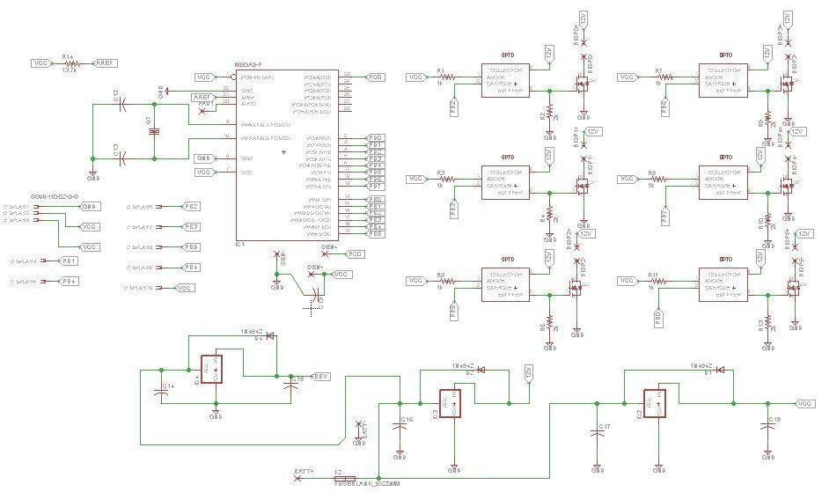
Control Board Schematic

Slide 29
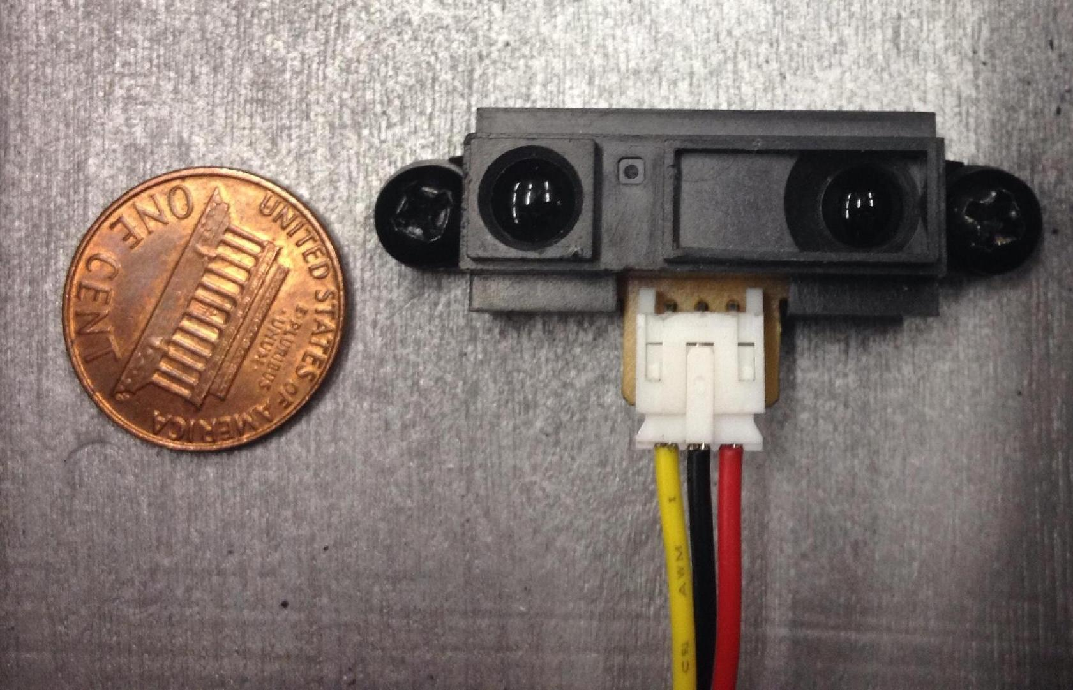
Sensor
Manufacturer | SparkFun
Part Number | SEN-00242
Price | 13.95
Power Supply | 3V
Distance | 10cm

Slide 30
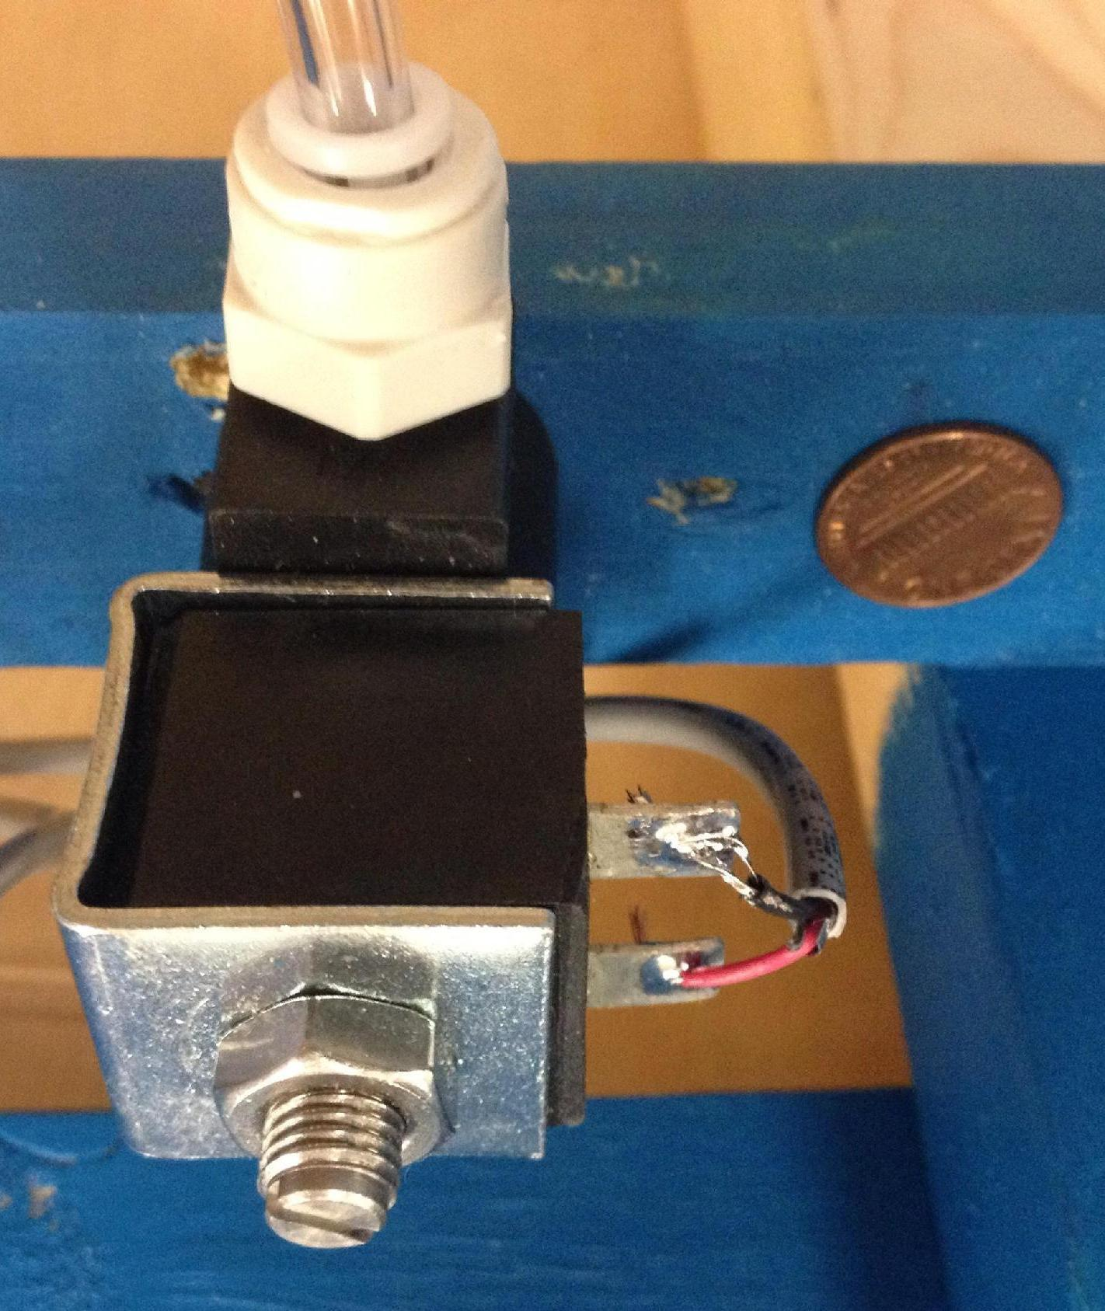
12V Solenoid Valves
Manufacturer | McMaster.Carr
Part Number | 7877K313
Price | 30.28
Pipe Size | 1/8
Maximum Psi | 25
Power Supply | 12V

Slide 31
Power Management
Solar Panel
MPPT
Controller
Battery
MPPT controller will regulate power from solar panel and output a steady voltage for battery charge with maximum efficiency

Slide 32
Solar Panel Specifications
Two 10 watt solar panel from power tech, Inc.
21.5 in height by 20.25 in width
Voltage at maximum power = 17.3V
Current at maximum power = .59 A
Since both panels will be parallel, the current will be doubled.

Slide 33
Charge Profile for Lead Acid Battery
A 12 volt 12 amp hour lead-acid battery will be used to power project.
A Constant voltage method will be to charge the battery
The beaglebone black will be used to implement the constant voltage algorithm
If battery voltage is lower than 12.55V, a constant charge voltage of 13.5V will be applied.
The battery is fully charge when its voltage is 12.65V, in which case the controller would go into and idle mode in which no charge voltage is applied.
Reprinted with permission from TI

Slide 34
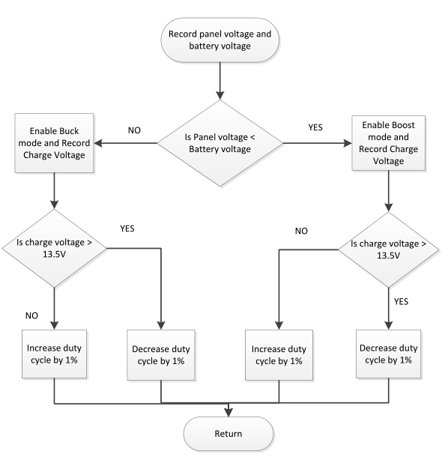
BeagleBone charge flow chart of method
Constant voltage algorithm that will maintain a charge voltage of 13.5 volts

Slide 35
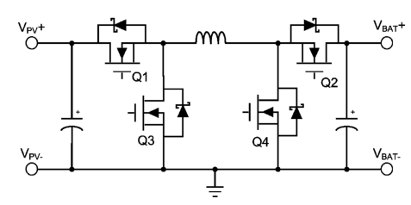
Buck-Boost Converter
A buck circuit and boost circuit in a full bridge configuration will be used to for DC/DC conversion
This is a energy effective way to step down or step voltage with minimal energy loss, due to energy storage in the indutor

Slide 36
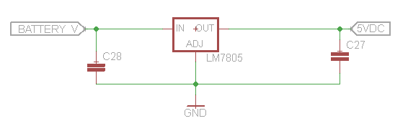
5 Volt Power Supply
The LM7805 is a 5 volt 1 Amp linear voltage regulator which will be used to power the BeagleBone

Slide 37
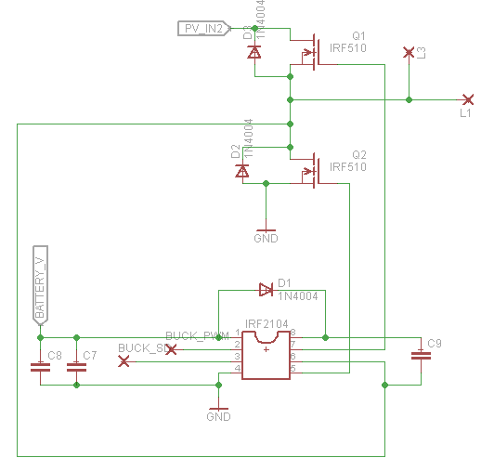
MOSFET Gate driver
The IRS2104 is a high voltage, high speed power MOSFET driver with high and low side dependent referenced channel output
Two IRS2104 will be used to drive the buck and the boost circuits

Slide 38
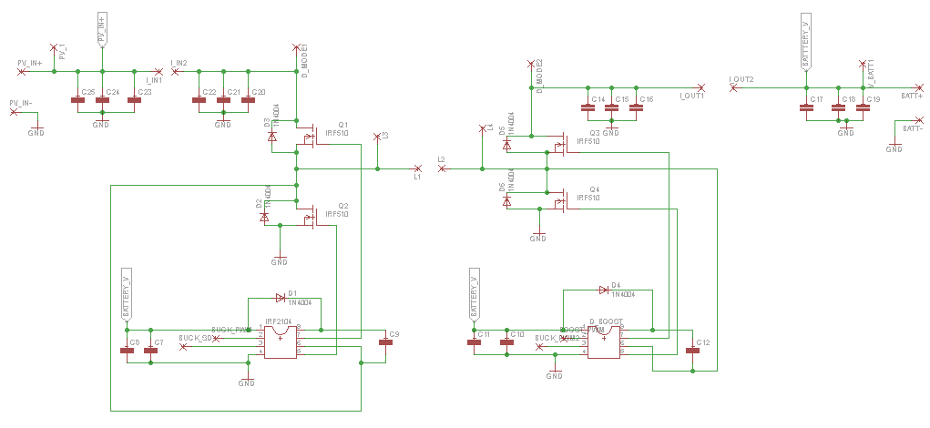
MPPT Controller schematic

Slide 39
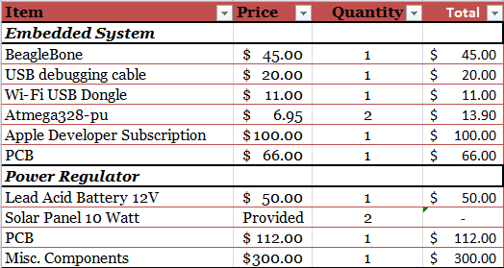
Budget & Financial Collaboration

Slide 40
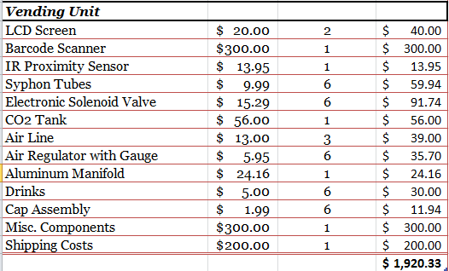
Budget & Financial Collaboration

Slide 41
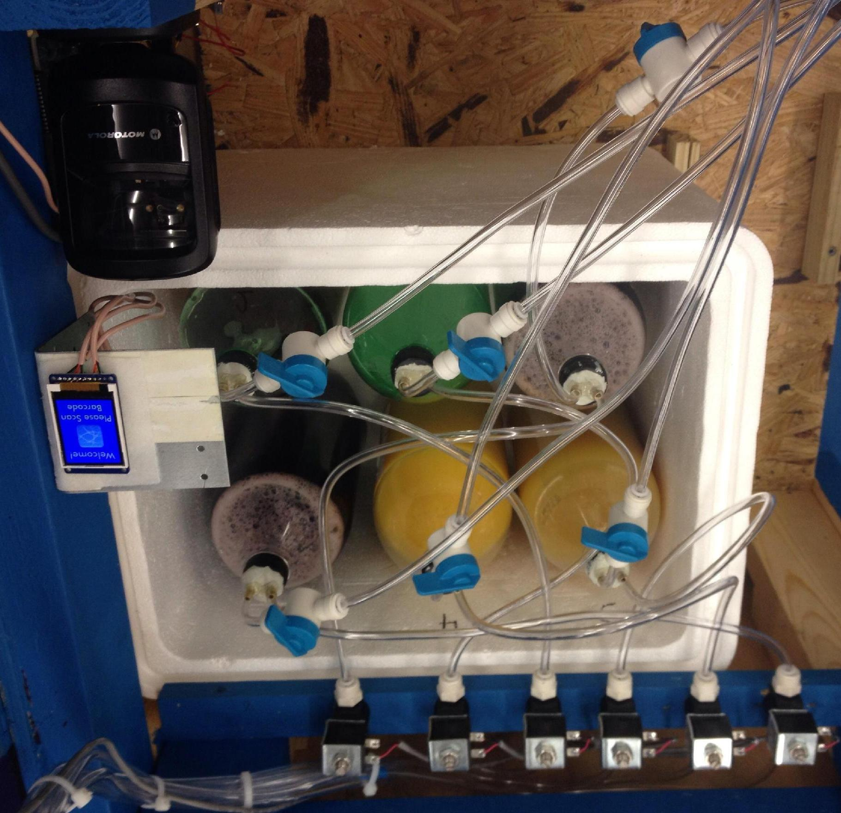
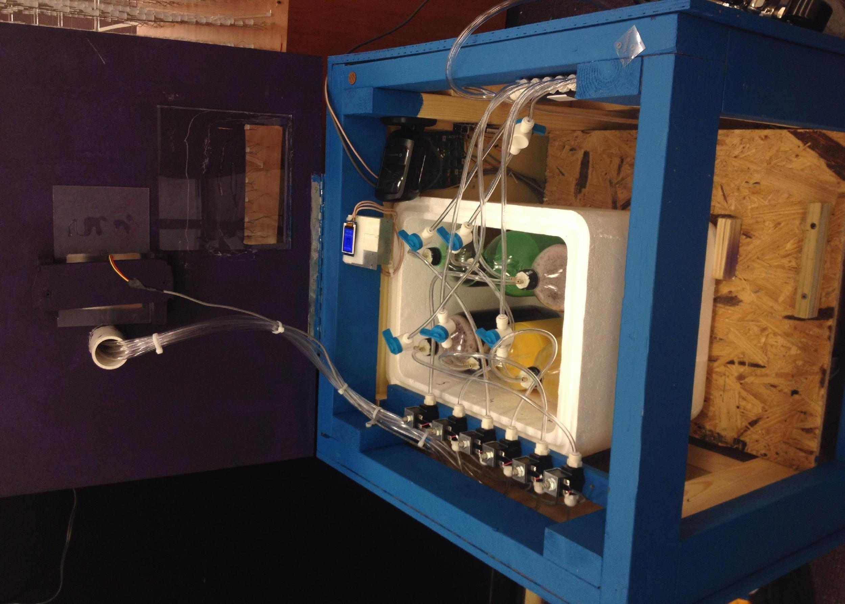
Model Design

Slide 42
MOSFET issues, turn on voltage Vgs and Rds(on). MOSFET does not open all the way leave a voltage drop across the the drain and source
Problems

Slide 43
QUESTIONS?
Notes:
October 27, 2005
*

